Slide 1
Reg Capital:Basel Capital Accords & SEC Capital Measurements

Slide 2
What is the BIS?
The Bank for International Settlements (BIS) is an intergovernmental organization of central banks which "fosters international monetary and financial cooperation and serves as a bank for central banks
Its not accountable to any national government.
The BIS carries out its work through subcommittees, the secretariats it hosts, and through its annual General Meeting of all members.
It also provides banking services, but only to central banks, or to international organizations like itself.
Based in Basel, Switzerland, the BIS was established by the Hague agreements of 1930.
Among other things, it regulates capital adequacy and encourages reserve transparency
It was originally intended to facilitate reparation payments imposed on Germany by the Treaty of Versailles after the First World War
http://en.wikipedia.org/wiki/Bank_for_International_Settlements

Slide 3
About the BIS
BIS is the world's oldest international financial organization with 60 member central banks, representing countries that together make up about 95% of world GDP.
Head office in Basel, with two representative offices: in Hong Kong and Mexico City.
Its mission is to serve central banks in their pursuit of monetary and financial stability, to foster international cooperation in those areas and to act as a bank for central banks.
In broad outline, the BIS pursues its mission by:
fostering discussion and facilitating collaboration among central banks;
supporting dialogue with other authorities that are responsible for promoting financial stability;
carrying out research and policy analysis on issues of relevance for monetary and financial stability;
acting as a prime counterparty for central banks in their financial transactions; and
serving as an agent or trustee in connection with international financial operations.
Monetary and financial stability is a precondition for sustained economic growth and prosperity. Reflecting the public good character of this goal, the BIS also makes part of its work available free of charge to the wider public, including:
its own analyses of monetary and financial stability issues;
international banking and financial statistics that underpin policymaking, academic research and public debate.
The customers of the BIS are central banks and international organizations.
As a bank, the BIS does not accept deposits from, or provide financial services to, private individuals or corporate entities.
BIS promotes international cooperation among monetary authorities and financial supervisory officials through its meetings programs and through the Basel Process - hosting and supporting international committees and standard-setting bodies and facilitating their interaction.

Slide 4
Basel Process
Basel Process refers to role of BIS in hosting / supporting work of international secretariats engaged in standard setting and pursuit of financial stability.
Co-location at the BIS communication / collaboration among these groups as well as interaction with central bank Governors and other senior officials in the context of the BIS's regular meetings programme.
The BIS also supports the work of these committees and associations with its expertise in economic research and its practical experience in banking.
The outcomes of the Basel Process are visible to public in form of reports that analyze specific topics and, in the form of internationally agreed standards. International agreement is the precondition for globally consistent standards.
Not a substitute for national legislation - to become binding, agreements reached have to be approved and implemented at national level, following due regulatory and legislative processes in each individual jurisdiction.
The Basel Process is based on three key features:
synergies of co-location mentioned above,
flexibility and openness in the exchange of information,
support from BIS expertise in the field of economics, banking and regulation.

Slide 5
Basel Process:Synergies
The BIS hosts the secretariats of nine groups that contribute to the pursuit of financial stability with their own respective governance and reporting lines.
Groupings of central banks and supervisory authorities set agendas of 6 groups:
The Basel Committee on Banking Supervision: the global standard setter for prudential regulation of banks that provides a forum for cooperation on banking supervisory matters. Its mandate is to strengthen regulation, supervision and practices of banks worldwide with purpose of enhancing financial stability.
The Committee on the Global Financial System: monitors and analyses the broad issues relating to financial markets and systems.
The Committee on Payments and Market Infrastructures: analyses and sets standards for payment, clearing and settlement infrastructures.
The Markets Committee: examines the functioning of financial markets.
The Central Bank Governance Forum: comprises Central Bank Governance Network, which facilitates exchange of information on institutional arrangements and the Central Bank Governance Group, which discusses issues related to the design and operation of central banks.
The Irving Fisher Committee on Central Bank Statistics (IFC): addresses statistical issues of concern to central banks, including those relating to economic, monetary and financial stability.
In addition, the BIS hosts three groups that have their own legal personality:
the Financial Stability Board (FSB);
the International Association of Deposit Insurers (IADI); and
the International Association of Insurance Supervisors (IAIS).
The physical proximity at the BIS creates synergies that, regardless of the variation in governance arrangements, produce a broad and fruitful exchange of ideas.

Slide 6
Basel Process: Flexibility and Supportive BIS Experience
Flexibility. The limited size of these groups is conducive to flexibility and openness in the exchange of information, thereby facilitating coordination and preventing overlaps and gaps in their work programmes. At the same time, their output is much larger than their limited size would suggest, as they are able to leverage the expertise of the international community of central bankers, financial regulators and supervisors, and other international and national public authorities.
Supportive BIS expertise and experience. The work of the Basel-based committees is informed by the BIS's economic research and, where appropriate, by the practical experience it gains from the implementation of regulatory standards and financial controls in its banking activities.
The work of the groups that are part of the Basel Process is shared more widely through various channels.
The Bank's own Financial Stability Institute (FSI) facilitates the dissemination of the standard-setting bodies' work to central banks and financial sector supervisory and regulatory agencies through its extensive programme of meetings, seminars and online tutorials.

Slide 7
What is the BCBS?
Responding to the 1974 Herstatt debacle, the G-10 countries formed a standing committee under the auspices of the BIS.
Called the Basel Committee on Banking Supervision, it comprises representatives from central banks and regulatory authorities.
the focus has evolved, embracing initiatives designed to:
define roles of regulators in cross-jurisdictional situations;
ensure that international banks or bank holding companies do not escape comprehensive supervision by a "home" regulatory authority;
promote uniform capital requirements so banks from different countries may compete with one another on a "level playing field."
The Basel Committee's does not have legislative authority, but participant countries are implicitly bound to implement its recommendations.
Usually, the committee has allowed for some flexibility in how local authorities implement recommendations, so national laws vary.
http://www.riskglossary.com/link/basle_committee.htm

Slide 8
What is the Basel Committee?
Purpose: encourage convergence toward common approaches & standards.
Not a classical multilateral organization - no founding treaty.
Does not issue binding regulation; functions as an informal forum in which policy solutions and standards are developed.
Committee's members from Argentina, Australia, Belgium, Brazil, Canada, China, France, Germany, Hong Kong, India, Indonesia, Italy, Japan, Korea, Luxembourg, Mexico, the Netherlands, Russia, Saudi Arabia, Singapore, South Africa, Spain, Sweden, Switzerland, Turkey, the UK and US.
The Committee's Secretariat is located at the Bank for International Settlements (BIS) in Basel, Switzerland, BUT the BIS and the Basel Committee remain two distinct entities

Slide 9
What, Exactly, is Capital?
Capital is essentially a buffer that banks set aside to protect them from going insolvent when faced with losses.
These losses can come from market risk exposure – i.e., movements in financial variables that affect the value of the bank’s holding of securities.
Or these losses can come from counterparty credit risk exposure – i.e., from failures of the bank’s counterparties to pay on their obligations.
Capital adequacy regulations are written by agencies such as the Bank for International Settlements (BIS) and local regulators such the FRB, the FSA, etc. BIS drafts the so-called Basel Accords, the key methodology prescriptions.

Slide 10
What, Exactly, is Capital?
From a regulatory standpoint, capital held by a bank is tiered into various “quality grades”.
Tier 1: Common Stock and Retained Earnings.
Tier 2: Supplementary bank capital that includes items such as revaluation reserves, undisclosed reserves, hybrid instruments and subordinated term debt.
Tier 3: “Everything else” – a greater number of subordinated issues, undisclosed reserves and general loss reserves.
The regulatory formulas compute “RWA” – Risk Weighted Asset – values for market risk, credit risk, and operational risk.

Slide 11
Components of Capital
CET1
Additional Tier 1
Tier 2
Total Capital

Slide 12
CET1
Common equity tier 1 capital is the most loss-absorbing form of capital.
Includes
qualifying common stock
related surplus net of treasury stock;
retained earnings;
certain accumulated other comprehensive income (AOCI),
+/- regulatory deductions or adjustments as appropriate;
qualifying common equity tier 1 minority interests.
Federal banking agencies expect the majority of CET1 to be in the form of common voting

Slide 13
Additional Tier 1
AT1 consists of capital instruments that are continuous: no fixed maturity:
Preferred shares
Contingent convertible securities (CoCos)
These perpetual instruments must contain no incentive for issuer to redeem them.
CoCos are a major component of AT1 and their structure is shaped by their purpose as a readily available source of capital for a firm in crisis.
They characteristically absorb losses prior to, or at, the point of insolvency and the activation of this absorption must be a function of the capitalization levels of the issuing firm.
CoCos can absorb losses either by:
Converting into common equity; or
Suffering a principal write-down.
AT1 instruments must either convert into ordinary shares or have principal written down (permanently or temporarily) if ratio of firm’s CET1 to its total RWA < 5.125%
In the event of resolution, claims of AT1 rank above ordinary shareholders but subordinated to claims of holders of Tier 2 , senior creditors and depositors.
http://www.corep.support/what-is-additional-tier-1.html

Slide 14
Tier 2
Tier 2 capital includes
allowance for loan and lease losses up to 1.25% of RWA
qualifying preferred stock,
subordinated debt, and
qualifying T2 minority interests, less deductions in the T1 instruments of an unconsolidated financial institution.
Part 324 of FDIC Rules eliminates previous limits on term subordinated debt, limited-life preferred stock, and the amount of tier 2 capital includable in total capital.

Slide 15
Tier 1 Leverage ratio
Tier 1 leverage ratio , introduced by Basel III in 2009 is relationship between core capital and total assets.
Calculated by dividing Tier 1 by average total assets and certain OBS exposures.
Tier 1 ratio is used to ensure capital adequacy of banks and place constraints on degree to which a bank can leverage its capital.
Numerator is common equity, R/E, reserves and certain instruments with discretionary dividends and no maturity.
Denominator is total exposures, including assets, derivatives and OBS items
Basel III required banks to include OBS exposures, such as commitments to provide loans to third parties, standby LCs, acceptances and trade LCs.
Basel III established a 3% min requirement for the Tier 1 leverage, and might make threshold even higher for certain SIFIs.
In 2014, Fed ,OCC and FDIC set rules with higher ratios for large banks as of Jan ‘18
BHCs >$700 bn in consolidated total assets or > $10 tr AUM must maintain additional 2% buffer, making minimum ratios 5%.
If insured institution covered by corrective action framework (demonstrated past capital deficiencies), it must have at > 6% ratio to be considered well capitalized.
http://www.investopedia.com/terms/t/tier-1-leverage-ratio.asp

Slide 16
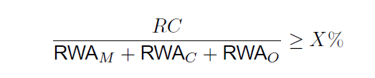
Capital Ratios
The regulatory capital (RC) requirements then take the form
where X depends on the Accord: 8% for Basel 2, 10.5% for Basel 3.
There are also restriction on Tier 1 capital alone. Certain “globally systemically important” banks (G-SIBs) need to post more Tier 1 capital than other banks.

Slide 17
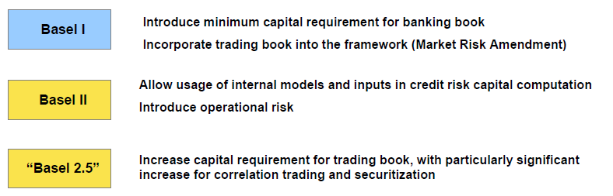
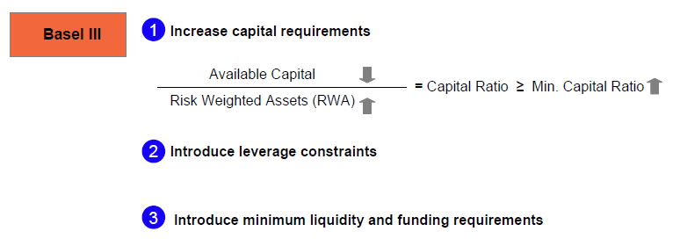
Basel Framework Summary

Slide 18
Balance Sheet vs. RWA
Operational Risk
Market Risk
Credit Risk
Market Risk
+ Credit Risk
+ Operational Risk ⁽²⁾
= Total Risk-Weighted Assets (RWA)
RWA

Slide 19
Initial Capital Accord (Basel I)
Initial Capital Accord approved and issued in 1988, with four basic goals in mind.
To set an international standard – “level playing field” – for all “large, internationally active” banks
To risk weight bank assets by credit risk (“the risk of counterparty failure”)
To capture the credit risk of off-balance sheet items
To emphasize “core” capital components over “supplementary” capital components

Slide 20
Initial Capital Accord
Balance Sheet Items Credit Risk Weight
Cash 0%
Due From Banks 20-100%
Investment Securities (debt) 0-100%
Residential Real Estate 50%
Commercial Loans 100%
All Other Assets 100%

Slide 21
Initial Capital Accord
Tier II Capital Components …
General loan loss reserves
Revaluation reserves (general)
Revaluation reserves (long-term, available-for-sale securities)
Hybrid capital (including perpetual preferred stock)
Subordinated Debt
Restrictions
Total of Tier II can not exceed the amount of Tier I
Total of loan loss reserves limited to 1.25% of risk assets –
Total of subordinated debt can not exceed 50% of Tier

Slide 22
Initial Capital Accord (1988)
Total Capital
------------------------------------------------------ =
Credit risk weighted assets
Bank’s Capital Ratio (%)

Slide 23
Initial Capital Accord Impact
Most banks raised their capital levels.
Estimates are that most banks maintain a capital ratio in excess of 10% and a Tier I capital ratio in excess of 6%.
The largest, internationally active banks calculate their capital in a similar manner, which facilitates comparisons for market participants.

Slide 24
Market Risk Amendment (1996)
Market risk is defined as the risk of losses in on and off-balance sheet positions arising from movements in market prices. The risks subject to this requirement are …
Foreign exchange risk
Commodities risk
Interest rate risk*
Equity (as an asset) risk*
Options risk
*denotes trading portfolio only

Slide 25
Market Risk Amendment (1996)
In measuring market risks, a choice between two broad methodologies will be permitted, subject to approval of banking supervisors.
Standardized method
Internal models method
This marked the first attempt by the Basle Committee to allow banks to use their own models for capital calculations.
Standardized method uses a “building block” approach in which “specific risks” and “general market risks” of equity and debt instruments are measured through pre-set ratios.
This approach is highly formulaic and straightforward, if highly detailed

Slide 26
Market Risk Amendment (1996)
The internal models method allows banks to use risk measures derived from their own internal risk management models, subject to seven conditions.
General criteria concerning adequacy of the risk management system.
Qualitative standards for internal oversight of the use of models.
Guidelines for specifying an appropriate set of market risk factors (i.e. the market rates and prices that affect the value of a banks’ positions).
Quantitative standards setting out the use of common minimum statistical parameters for measuring risk
Guidelines for stress testing.
Validation procedures for external oversight of the use of internal models (i.e external audits).
Rules for banks which use a mixture of models and standardized approaches. Banks may use standardized approaches for certain risk and internal models for others.

Slide 27
Market Risk Amendment (1996) Equities Risk
Expressed in terms of two separately calculated capital charges for the “specific risk” and “general market risk”
“Specific risk” is defined as the bank’s gross equity positions or the sum of all long and all short positions.
“General market risk” is the overall net position in an equity market.
The capital charge for specific risk is 8% and the capital charge for general market risk is 8%.
The minimum capital charge requirement is expressed in terms of two charges, one for “specific risk” and the other to the “general market risk” in the trading portfolio,.

Slide 28
Market Risk Amendment (1996)
Interest Rate Risk
“General market risk” charges designed to capture the risk arising from changes in market interest rates.
In either the “maturity” method or the “duration” method, the capital charge is the sum four components:
The net long or short position in the trading portfolio,
The “vertical allowance”,
The “horizontal allowance”, and
The net charge for positions in options
The market risk charge is the sum of component charges.
This is then multiplied by the inverse of the minimum capital ratio to translate to an RWA equivalent amount.
The “specific risk charges” were graduated in 5 categories as follows:
Government 0.00%
Qualifying #1 (IG by 2 rating agencies) 0.25%
Qualifying #2 (IG by 1 rating agency) 1.00%
Qualifying # 3 (supervisor approval) 1.60%
Other 8.00%

Slide 29
Market Risk Amendment (1996)
Total Capital
------------------------------------------------------ =
Credit risk + Market Risk
Bank’s Capital Ratio (%)
Market Risk RWA = 12.5 * m * VaR + specific risk add-on.
Here, m = supervisory multiplier > 3 and is based upon backtests

Slide 30
Basel II
Basle Committee decided the then current version of Capital Accord needed enhancement.
Why was the revision necessary?
may have actually contributed to Asian financial crisis
Banks are more often involved in non-banking activity.
OECD references out of date
The basic goals of the Basel II were:
To increase risk sensitivity of min capital requirements
to maintain overall level of capital while aligning it more closely with the true underlying risks
To encompass supervisory review and market discipline within capital regulation.

Slide 31
Basel II Changes
Basel II has three “pillars
The first pillar is the capital calculation, amending the 1988 Accord.
Tier I and Tier II capital are unchanged.
Minimum capital required unchanged at 8%.
Market risk component left unchanged.
Credit risk to be made more precise.
Operational risk to be included.
The second pillar deals with capital adequacy calculations – how much more than the minimum capital requirements does a bank need?
The third pillar deals with transparency – what information made available to the public to bring more market discipline to this process?

Slide 32
The 3 Pillars
Basel II
Pillar 1
Pillar 2
Pillar 3
Regulatory capital / Minimum capital requirements
Supervisory review process ICAAP (Internal Capital Adequacy Assessment Process)
Market disclosure

Slide 33
Pillar 1
Deals with maintenance of regulatory capital calculated for credit, operational, market risk.
Total risk-weighted assets are determined by multiplying the capital requirements for market risk and operational risk by 12.5 (i.e. the reciprocal of the minimum capital ratio of 8%) and adding the resulting figures to the sum of risk-weighted assets for credit risk.

Slide 34
Pillar 2
The second pillar refers to the method of computing capital “adequacy”.
To date, the Basle Committee has only set a minimum percentage of capital; however, this has often been confused with adequacy.
Basel II identifies 4 key principles of supervisory review of capital adequacy.
Banks should have a process for assessing their overall capital adequacy
Supervisors these assessments
Supervisors should expect banks to operate above the minimum regulatory capital ratios
Supervisors should intervene when necessary

Slide 35
Pillar 3
The third pillar refers to transparency of capital calculations.
Purpose: encourage market discipline by developing disclosure
Disclosures required on a semi-annual basis, with two exceptions:
An institution must disclose Tier I capital and total capital on a quarterly basis.
An institution must disclose information about its risk management practices on an annual basis.
Subsequent information that would materially change any previous disclosure should be disclosed as soon as possible.
Banks are required to disclose several tables of information, including qualitative disclosures and quantitative disclosures.

Slide 36
Basel II Changes
Credit Risk
Standardized Approach
Internal Ratings Based Approach – Foundation Model
Internal Ratings Based Approach – Advanced Model
Operational Risk
Basic Indicator Approach
Standardized Approach
Advanced Measurement Approach
Market Risk
Securitization Framework

Slide 37
Basel II Credit Risk
Balance Sheet Items Credit Risk Weight
Cash 0%+ (new)
Due From Banks 20-150% (new)
Investment Securities (debt) 0-150% (new)
Residential Real Estate 35% (new)
Retail Credit Portfolios 85% (new)
Commercial Loans 20-150% (new)
Past Due Loans 150% (new)
All Other Assets 100%

Slide 38
Basel II Credit Risk
Other new factors, associated with credit risk weightings:
residential real estate
retail loans pools, including certain pools of small business loans
Past due loans
Banks may choose one of two general approaches to calculate credit risk:
the Standardised Approach, and the
Internal Ratings Based approach (IRB) .
In the Standardised Approach risk weights are given by the Committee.

Slide 39
Basel II Credit Risk
Internal Ratings Based Approaches rely on four quantitative inputs:
Probability of Default (PD) measures the likelihood that a borrower will default over a give period of time.
Loss Given Default (LGD) measures the proportion of the exposure that will be lost if a default occurs.
Exposure at Default (EAD) is the amount of loans and, for loan commitments the amount of the facility that is likely to be drawn if a default occurs.
Maturity (M) is the remaining maturity of an exposure.

Slide 40
Basel II Credit Risk
Example: corporate, bank and sovereign exposures
Data Input | Foundation IRB | Advanced IRB
PD | Provided by bank | Provided by bank
LGD | Provided by supervisor | Provided by bank
EAD | Provided by supervisor | Provided by bank
M | Provided by supervisor | Provided by bank

Slide 41
Basel II Credit Risk
For retail exposures, only one internal ratings based approach (advanced) is applicable.
Retail exposures are divided into three categories:
Residential mortgages;
Revolving retail exposures;
Other retail (including loans to small businesses)
Banks must estimate the PD, LGD, EAD and M for each category.

Slide 42
Basel II Credit Risk
A new category is included for specialized lending, where repayment is highly dependent on the performance of a pool of assets or on the collateral (i.e. such as high value commercial real estate lending).
Finally, equity portfolios in the banking book are risk weighted at a minimum of 100%.
The Basle Committee has set out detailed instructions on the minimum criteria and testing requirements for any bank wishing to use an internal ratings based model.
Any bank wishing to adopt an internal ratings based model for capital calculation will be required to run the model in parallel with the standardized version for at least one year to show the impact of the internal model on capital calculations.

Slide 43
Basel II Securitization
Securitizations now much more advanced and are specifically addressed in Basel II.
banks have become much more sophisticated with their use of securitization, and many have used securitizations for capital arbitrage.
Securitizing a pool of loans, yet keeping the pool on the originating bank’s balance sheet as an investment security with a lower risk weight – changes the risk weight from 100% to 20%, yet the real credit risk is virtually unchanged.
Basel II attempts to limit banks ability to use securitizations for capital arbitrage.

Slide 44
Securitization Framework
In December 2014, BCBS published final Basel III Document on changes to credit risk capital requirements for securitization transactions.
Revised Framework will replace securitization framework set out in Basel II
Revised Framework is to be implemented by the beginning of 2018.
To determine credit risk capital for a securitization exposure, a bank will apply one of several approaches according to the following:
IRB Approach based on internal ratings-based approach capital charge for underlying securitised exposures
either an External Ratings-Based Approach (ERBA), which determines risk weights based on qualifying credit rating agency ratings and other variables, or,
in the case of unrated exposures to ABCP conduits, Internal Assessments Approach from the Basel II IRB;
Standardized Approach which determines RW using simple formula applied to capital requirement for underlying assets determined under Basel II standardized approach.
If bank is not able to apply any of these to a particular securitization exposure, it must assign a 1,250% risk weight.
Mayer Brown | Revisions to Basel Securitisation Framework – Final Rules

Slide 45
Securitization Framework
Regardless of the approach used, the capital requirement for any securitization exposure will be subject to a 15% risk weight floor
a lower risk weight may apply if the max RW or max capital requirement are applicable and give a lower RW according to the weighted average RW or the capital requirement of the underlying pool of exposures).
Under both the IRBA and the ERBA, RW will vary according to maturity of the securitization exposure, with a minimum of one year and a maximum of five years.
For this purpose, the tranche maturity will be determined based on mandatory contractual cash flows of the securitisation tranche rather than contractual or expected cash flows of the underlying assets. •
Based on the ERBA RW in the Revised Framework, RW under the Revised Framework for relatively high quality securitization tranches will in general be substantially higher than under the Basel II IRB.

Slide 46
Basel II Operational Risk
Operational risks was a controversial part of Basel II.
Operational risk is defined as “the risk of losses resulting from inadequate or failed internal processes, people and systems or from external events”.
While the method of operational risk assessment is not overly precise, the Basle Committee considered it necessary to include this area in capital adequacy requirements.
Operational risk is separated by business line in the following manner:
Investment banking;
Commercial banking (corporate and retail);
Other financial services, such as insurance, discount brokerage, asset management, etc.
Capital should be allocated to each of these activities.

Slide 47
Basel II Operational Risk
Basel II has given guidance to 3 broad methods of Capital calculation for Operational Risk
Basic Indicator Approach - based on annual revenue of the Financial Institution
Standardized Approach - based on annual revenue of each of the broad business lines of the Financial Institution
Advanced Measurement Approaches - based on the internally developed risk measurement framework of the bank adhering to the standards prescribed (methods include IMA, LDA, Scenario-based, Scorecard etc.)
The Operational Risk Management framework must include identification, measurement, monitoring, reporting, control and mitigation frameworks for Operational Risk.

Slide 48
Basel II Operational Risk
BIA is to multiply the average gross revenue figure for the bank by 0.15 to get a capital charge.
This figure is then divided by the inverse of the minimum capital ratio to arrive at an addition to total risk-weighted assets.
Standard Approach uses Business Line Beta Factor
Corporate finance 18% Trading and sales 18%
Retail banking 12% Commercial banking 15%
Payment & settlement 18% Agency services 15%
Asset Management 12% Retail Brokerage 12%
AMA is actuarial using frequency and severity

Slide 49
Operational Risk RWA
Types of Operational Risk
Clients Products and Business Practices
Internal Fraud
Employment Practices and Workplace Safety – Firm
External Fraud
Damage to Physical Assets
Business Disruption and Systems Failure
Execution, Delivery and Process Management
FREQUENCY
Inputs
Model
Outputs
Frequency of
Internal Loss Data
Frequency
SEVERITY
Internal Loss Data (>20K)
Aggregate Loss Distribution (ALD)
Severity- ILD
Monte Carlo
Simulation
Scenario Analysis (SA) Workshop (>$10MM)
99.9% VaR
Loss Data
BEICFs
Business
Estimate
Severity-SA
Sub Model
Severity
Based on industry data, portfolio info, KRI’s etc.
Loss Data
BEICFs
Legend:
ILD: Internal Loss Data
SA: Scenario Analysis
BEICF: Business Environment & Internal Control Factor
RCSA: Risk and Controls Self Assessment
KRI: Key Risk Indicator
VaR: Value at Risk
ES: Expected Shortfall
Operational Risk
Regulatory Capital
/ 8%
Operational RWA
Basel II Changes

Slide 50
IDRC
The Basel/IOSCO Agreement reached in July 2005 contained several improvements to the capital regime for trading book positions.
Among revisions to Market Risk Amendment was new requirement for banks that model specific risk to measure and hold capital against default risk incremental to any default risk captured in the VaR model.
The incremental default risk charge (IDRC) was incorporated into the trading book capital regime in response to the increasing amount of exposure in banks' trading books to credit-risk related and often illiquid products whose risk is not reflected in VaR.
This later morphed into IRC

Slide 51
http://www.basel-ii-accord.com/Basel_ii_538_to_643_Securitization.htm
Securitization Framework
Banks must apply the securitization framework for determining regulatory capital requirements on exposures arising from traditional and synthetic securitizations or similar structures that contain features common to both.
Since securitizations may be structured in many different ways, the capital treatment of a securitization exposure must be determined on the basis of its economic substance rather than its legal form.
Similarly, supervisors look to the economic substance of a transaction to determine whether it should be subject to the securitization framework for purposes of determining regulatory capital.
The risk-weighted asset amount of a securitization exposure is computed by multiplying the amount of the position by the appropriate risk weight determined in accordance regulatory tables.

Slide 52
Basel II (2003-2007)
Total Capital
------------------------------------------------------ =
Credit risk + Market Risk + OpRisk + IDRC+Securitization Framework
Bank’s Capital Ratio (%)

Slide 53
Basel 2.5
Stressed VaR
IRC
Securitizations
CRM
multiple defaults
spread risk
correlation vol
index-single name basis
index-bespoke portfolio basis
recovery vol
hedge slippage

Slide 54
Governance, Oversight, and Reporting
Product inventory containing all trading products
Whether it is a “covered position”.
The business line which trading this product.
The valuation model applied to mark the product to market
The regulatory capital model and/or add-ons that apply to the product:
The gross positive and gross negative notional outstanding on the product.
Organizational charts, committee charters, membership lists
Presentations made to management related to internal market risk models.
Reporting used by management to monitor and manage market risk.
Firm’s processes to stress test the market risk of its covered positions.
Gap analysis of the firm’s compliance with the rule, project plans with associated timelines for full compliance with the rule or ongoing enhancements, and analysis or controls that ensure compliance with the rule.

Slide 55
Trading and Covered Positions & Capital
Trading and Covered Positions
Policies and procedures for determining correlation positions
Documented trading and hedging strategies for the firm’s trading positions
Policies and procedures for the identification and active management of the firm’s covered positions, including
Documentation of any recent or planned reclassifications of trading positions
Policies and procedures governing the valuation of covered positions, including marking, price verification and VAs or reserves.
Capital
Policies and procedures for the calculation and reporting of market risk, adjusted risk weighted assets, and relevant capital ratios.
Recent reporting of the components of market risk equivalent assets and other measures referenced in request item
Inventory of de minimis exposures and the relevant calculation of capital for these exposures.

Slide 56
VaR
Organizational charts for model development units in risk
Model documentation
Justification the firm’s calculation of 10-day VaR.
Risk factor proxies used in VaR and analysis justifying use
Risks that are not captured in VaR.
Analysis demonstrating the VaR conservatively assesses risks arising from less liquid positions and positions with limited price transparency
Firm’s process for re-estimating, re-evaluating, and updating VaR
Documentation of the firm’s process to update market data
Firm-wide and subportfolio backtesting methodology
Inventory of significant subportfolios for subportfolio backtesting
List of any covered positions excluded from VaR or excluded from firm-wide and/or subportfolio backtesting

Slide 57
Stressed VaR & CRM
Stressed VaR
Model documentation including differences between VaR & SVaR
Governance and analysis of firm’s processes for identifying, the period of significant financial stress
List of any covered positions excluded from SVaR
CRM
Model documentation for all models used to calculate CRM
Summary of any correlation trading positions that are
included in CRM but not measured with an internal specific risk model; and
included in an internal specific risk model but not in CRM.
Analysis demonstrating CRM conservatively assesses risks from less liquid positions and positions with limited price transparency
Documentation of the firm’s process for re-estimating, re-evaluating, and updating CRM to ensure continued applicability and relevance.
Stress testing methodology and results for supervisory stress scenarios applied to the firm’s correlations trading positions.

Slide 58
IRC & Specific Risk
IRC
Model documentation
Summary of any positions that are
1) included in IRC but not measured with an internal specific risk model; and
2) included in an internal specific risk model but not in IRC. Please include the number of positions, market value, and a rational for any exclusion.
Analysis identifying and justifying the appropriateness of any proxies
Analysis demonstrating IRC conservatively assesses risks arising from less liquid positions and positions with limited price transparency
Documentation of the firm’s process for re-estimating, re-evaluating, and updating IRC to ensure continued applicability and relevance.
Specific Risk
list of all positions that receive standardized specific risk add-ons.
Description of how specific risk add-on requirements are being applied.
internal specific risk model documentation

Slide 59
‘Independent Verification and Validation
Organizational charts for the firm’s validation groups
Policies and procedures for
Annual internal model review; and
Ongoing monitoring and outcomes analysis
Validation reports for models used to calculate market risk equivalent assets.
Results of Audits of the quality of inputs assumptions, parameter estimates, and calibration under alternative market scenarios.
Internal audit reports and workpapers demonstrating audit’s assessment market risk measurement systems, including
Activities of the business trading units and independent risk control units;
Compliance with policies and procedures; and
Calculation of the firm’s measures for market risk.
Internal audit’s reporting of its findings on the effectiveness of the controls supporting the market risk measurement systems to the firm’s board of directors.

Slide 60
Basel III capital Proposals
Higher Capital Standards
(Min + Conservation Buffer)
Additional Counter-Cyclical Buffer
Additional SIFI Buffer
Higher Quality of Capital
Higher Counterparty Risk Requirements
Introduce Leverage Ratio

Slide 61
Basel II.5 2013
Total Capital
------------------------------------------------------ =
Credit risk + Market Risk + OpRisk + IDRC+IRC+Securitization Framework + CRM + Stressed VaR + CVA
Bank’s Capital Ratio (%)

Slide 62
Basel 3
First, quality, consistency, and transparency of capital raised.
Tier 1 : must be common and retained earnings
Tier 2 capital instruments harmonized
Tier 3 capital will be eliminated.
Second, the risk coverage of framework strengthened.
integrated management of market and counterparty credit risk
Add the CVA risk due to deterioration in counterparty's credit rating
Strengthen the capital requirements for counterparty credit exposures
Raise the capital buffers backing these exposures
Reduce procyclicality and
Encourage move OTC derivative contracts to central counterparties
strengthen the risk management of counterparty credit exposures
including wrong-way risk in counterparty credit risk

Slide 63
Basel 3
Third, introduce leverage ratios as supplementary measures
Fourth, introduce capital buffers to be drawn in stress periods
Address procyclicality:
Dampen any excess cyclicality of the minimum capital requirement;
Promote more forward looking provisions;
build buffers at banks that can be used in stress; and
Achieve the broader macroprudential goal of protecting the banking sector from periods of excess credit growth.
Requirement to use long term data horizons to estimate probabilities of default,
downturn loss-given-default estimates to become mandatory
Improved calibration of the risk functions, which convert loss estimates into regulatory capital requirements.
Banks must conduct stress tests that include widening credit spreads in recessionary scenarios.
Promoting stronger provisioning practices (forward looking provisioning)

Slide 64
Basel 3
Fifth, the Committee is introducing a global minimum liquidity standard for internationally active banks that includes a 30-day liquidity coverage ratio requirement underpinned by a longer-term structural liquidity ratio called the Net Stable Funding Ratio.
The Committee also is reviewing the need for additional capital, liquidity or other supervisory measures to reduce the externalities created by systemically important institutions.

Slide 65
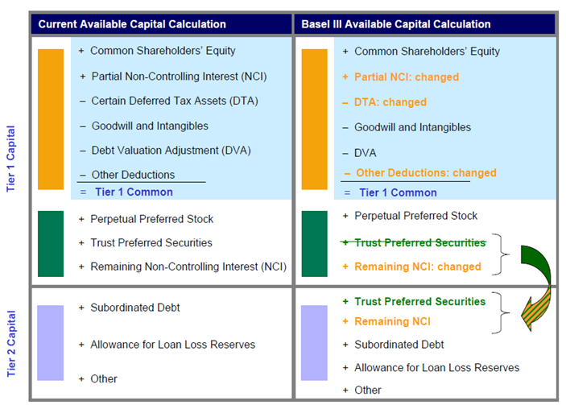
Restriction of Qualifying Available Capital

Slide 66
Risk Weighted Assets
Risk Weighted Assets
Operational Risk
Market Risk
Credit Risk

Slide 67
Market Risk RWA
Market Risk
Regulatory Capital
/ 8%
Market RWA
Standardized Charges
VaR-Based Charges
Stressed VaR Based Charges
IRC Charges
Correlation Trading Charges
+
+
+
+
99% Daily VaR
x
SQRT(10)
x
3
Securitization Standardized Charges
Other Standardized Charges
Stressed VaR
SQRT(10)
3
x
x
Basel II
Basel II.5 changes

Slide 68
Counterparty Credit RWA
Credit RWA
Credit Valuation Adjustment (CVA) Add-On
Credit Risk
Regulatory Capital
(
)
+
/ 8%
Exposure at Default (EAD)
X
Credit Risk Weight
(CRW)
Effective Expected Positive Exposure (EEPE)
Alpha
X
Probability of Default (PD)
Loss Given Default (LGD)
Maturity (M)
Correlation
Basel II
Basel III changes

Slide 69
Operational Risk RWA
Types of Operational Risk
Clients Products and Business Practices
Internal Fraud
Employment Practices and Workplace Safety – Firm
External Fraud
Damage to Physical Assets
Business Disruption and Systems Failure
Execution, Delivery and Process Management
FREQUENCY
Inputs
Model
Outputs
Frequency of
Internal Loss Data
Frequency
SEVERITY
Internal Loss Data (>20K)
Aggregate Loss Distribution (ALD)
Severity- ILD
Monte Carlo
Simulation
Scenario Analysis (SA) Workshop (>$10MM)
99.9% VaR
Loss Data
BEICFs
Business
Estimate
Severity-SA
Sub Model
Severity
Based on industry data, portfolio info, KRI’s etc.
Loss Data
BEICFs
Legend:
ILD: Internal Loss Data
SA: Scenario Analysis
BEICF: Business Environment & Internal Control Factor
RCSA: Risk and Controls Self Assessment
KRI: Key Risk Indicator
VaR: Value at Risk
ES: Expected Shortfall
Operational Risk
Regulatory Capital
/ 8%
Operational RWA
Basel II Changes

Slide 70
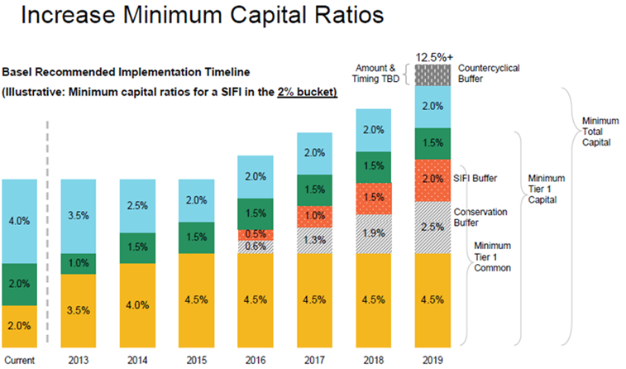




Minimum Capital Ratios

Slide 71
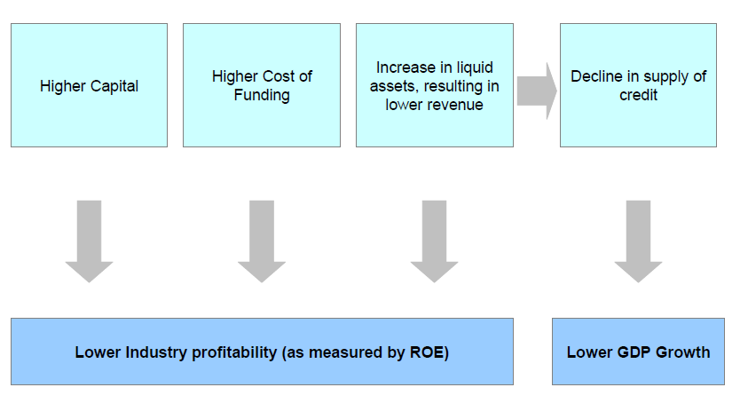
Expected Impact on Banking Industry and Economy

Slide 72
Implications of Basel III
Implications with Implementation ex. Dodd-Frank
International Counterparty Risks
Feasibility of Capital Ratios
Complexity
Regulators Enforceability
Delayed Implementation

Slide 73
Fundamental Review of the Trading Book: Basel IV
May 2012

Slide 74
Basel IV
Trading book/banking book boundary
Moving away from “intent”
Trading evidence
Valuation evidence
Stress Calibration (making sure you have capital when you need it most)
Movement away from VaR and to Expected Shortfall
Risk of Market Illiquidity
Former assumed 10-day horizon
Incorporation of “Liquidity Horizons” as taxonomic items
Incorporation of “Liquidity Horizons into metrics
Capital add-ons for jumps in liquidity premia

Slide 75
Basel IV
Treatment of Hedging and Diversification
Issues of basis risk
Disappearance of diversification when needed most
Constraining the modeling benefits of diversification
Internal Model vs Standardized Approaches
Recalibration to each other
Forced use of standardized approaches
Consideration of standardized approach as a floor

Slide 76
Basel IV
Revised Models-based approach
Revised scope of eligible businesses
Strengthen internal model standards
Modularize approvals
P&L Attribution
Enhanced daily backtesting: predicted vs actual
Revised Standardized Approach
Use as a fallback
Partial vs fuller risk factor bucketing
Appropriate Treatment of Credit: capture of default and migration

Slide 77
Basel IV
NOT IN SCOPE
Interest Rate Risk in the Banking Book
Interaction of market and ccp risk
Comments due September 7

Slide 78
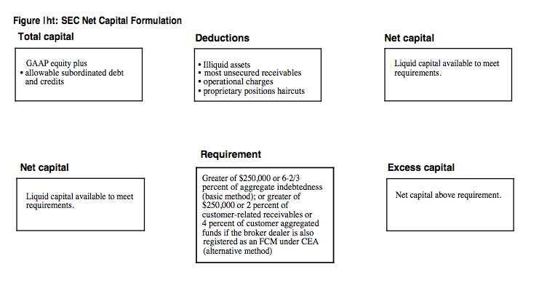
SEC Net Capital Rule

Slide 79
SEC Net Capital Rule
The uniform net capital rule created by SEC in 1975 to regulate broker-dealers
Rule requires firms to value their securities at market prices and to apply to those values a haircut based on each security's risk characteristics
Haircut values of securities used to compute liquidation value of a assets to determine whether enough liquid assets to pay its non-sub liabilities and still retain a "cushion" of required liquid assets to ensure payment of all customer obligations
In 2004, the SEC permitted large broker-dealers ("tentative net capital" > $5 b) to apply for exemptions from this established "haircut" method.
Firms were permitted to use models to compute haircuts based on banks standards.
Many say 2004 rule change as a cause of the crisis because it permitted a large increase in leverage
The 2004 rule change remains in effect. The companies that received SEC approval to use its haircut computation method continue to use that method, subject to modifications that became effective January 1, 2010.
Wikipedea

Slide 80
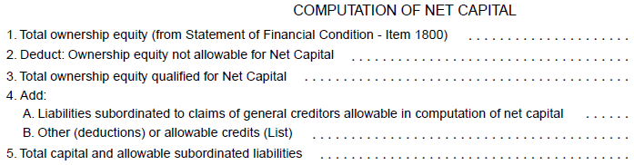
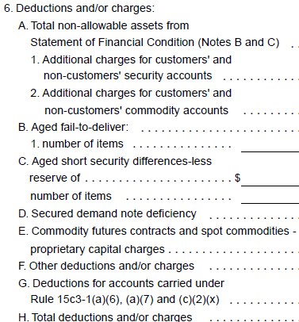
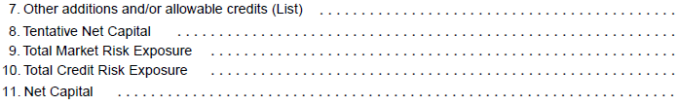
SEC Capital Calculation Worksheet

Slide 81
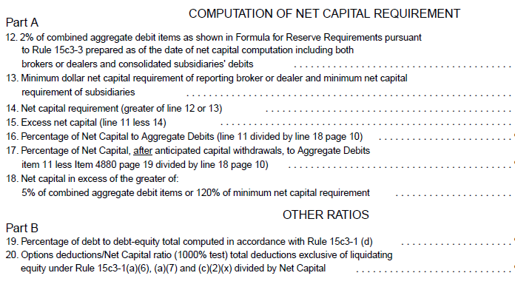

Slide 82
